Slide 1



Contract monthly claim system (cmcs)
Streamlining lecture claims, verification and approvals
By Inam ntshanga ST10443349
21 november 2025
Iie msa
Video link:
https://youtu.be/xgrqpu-JNIw
Primary Repo link: https://github.com/Ntshanga-Inam/prog6212_FinalPART3_ST10443349.git'
Backup Repo: https://github.com/IIEMSA/prog6212-part1-Ntshanga-Inam.git

Slide 2

The challenge
Manual Claim processes are time consuming and error-prone
Lack of transparency in approval workflows
Difficulty tracking claim status and payments
Inefficient document management
No centralized reporting or analytics
IMPACT: Delayed payments, administrative overhead, frustrated staff

Slide 3
Introducing CMCS
Automated claim submission and processing
Streamlined multi-level approval workflows
Real-time status tracking and notifications
Digital document management
Comprehensive reporting and analytics
BENEFITS: Faster processing times, reduced human errors, improved transparency.

Slide 4
Technical Foundation
ASP.NET Core MVC Framework
Responsive Bootstrap UI
Architecture: MVC Pattern with Repository Layer
MS SQL Server Db + Entity Framework
FluentValidation and Chart.js for Analytics

Slide 5
FOUR-ROLE ECOSYSTEM
LECTURER :
Submit monthly claims
Track claim status
Upload supporting documents
COORDINATOR:
Review & Validate claims
Automated business rule checks
Forward to Managers
3. Manager: Final approval authority Oversight and compliance Workflow management 4. HR: Payment processing Lecturer management Reporting & analytics

Slide 6

Auto-calculation of payments
• Real-time hours × rate calculation
• Instant total amount updates
📋 Dynamic claim items
• Add/remove work entries
• Automatic hour totaling
📎 Document upload
• Multiple file support
• Automatic validation
✅ Smart validation
• Client and server-side checks
• Business rule enforcement

Slide 7
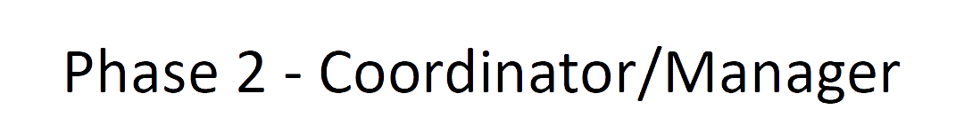
🔍 Automated Validation
• Pre-defined business rules
• Real-time claim checking
• Policy compliance verification
📋 Approval Dashboard
• Role-based claim filtering
• Status tracking
• Quick action buttons
🔄 Workflow Management
• Status progression: Submitted → Coordinator → Manager → Approved
• Automated notifications
• Audit trail

Slide 8
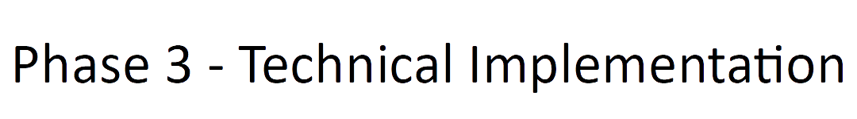
⚡ FluentValidation Integration
• Custom business rules
• Real-time validation feedback
• Configurable validation logic
🌐 RESTful Web API
• Frontend-backend communication
• Mobile-ready endpoints
• Standardized responses
🛡️ Security & Data Integrity
• Entity Framework data layer
• SQL Server transactions
• Proper error handling

Slide 9

💰 Payment Processing
• Bulk payment operations
• Individual claim processing
• Payment confirmation
📊 Advanced Reporting
• Monthly summary reports
• Payment period analysis
• Lecturer performance metrics
📈 Visual Analytics
• Interactive charts and graphs
• Status distribution
• Financial overview

Slide 10

📱 Responsive Design
• Bootstrap 5
• Mobile-friendly UI
🔧 API-First Architecture
• RESTful endpoints
• JSON data exchange
🎯 Entity Framework Integration
• Code-first database design
• Efficient data operations
• Relationship management
✅ Automated Business Rules
• Hours validation (0.5–200)
• Rate validation (R100–R1000)
• Monthly limits enforcement

Slide 11

🗃️ Core Tables:
• Users
• Claims
• ClaimItems
• Documents
• Approvals
🔗 Relationships:
• Users → Claims (1:M)
• Claims → ClaimItems (1:M)
• Claims → Approvals (1:M)
📊 Performance:
• Indexing
• FK constraints
• Efficient queries

Slide 12
Validation & Business Rules
⏰ Time Validation
• Max 200 hrs/month
• Min 0.5 hrs/entry
• Daily limits
💰 Financial Controls
• Rate limits (R100–R1000)
• Auto amount calculation
• Budget compliance
📋 Business Logic
• Claim month rules
• Workflow enforcement
• Role-based access control

Slide 13

🎨 Interface
• Clean UI
• Intuitive navigation
⚡ Performance
• Fast loads
• Real-time updates
📱 Accessibility
• Mobile responsive
• Keyboard friendly
🔍 UX Enhancements
• Status badges
• Tooltips

Slide 14
Benefits & Impact
🚀 Efficiency
• 70% faster processing
• Reduced errors
• Automated workflows
💸 Cost Savings
• Less admin work
• Less paper
📈 Transparency
• Real-time tracking
• Audit trail
😊 User Satisfaction
• Faster payments
• Reduced frustration

Slide 15
Technical Achievements
🏆 Architecture
• MVC
• Repository & services
🔧 Features
• FluentValidation
• EF optimization
• Async/await
🎯 Code Quality
• Error handling
• Logging
📊 Performance
• Optimized queries
• Indexes

Slide 16
Future Enhancements
🔮 Features
• Mobile app
• Email notifications
• Analytics
• Payroll integration
• Multi-language
• Advanced reporting
🚀 Scalability
• Cloud-ready
• Microservices
• API rate limiting
• DB sharding
🛡️ Security
• 2FA
• Role mgmt
• Audit logging
• Encryption

Slide 17
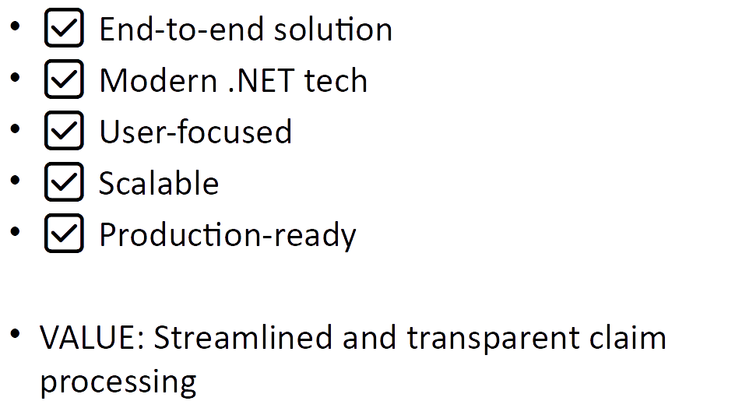
Conclusion

Slide 18
Thank you
By ST10443349
Repo link:
Video link: https://youtu.be/xgrqpu-JNIw

Slide 19

Reference
W3Schools (2025). W3Schools online web tutorials. [online] W3schools.com. Available at: https://www.w3schools.com/.

